Slide 1

Linguistic diversity in child language acquisition research
Sam Passmore The Australian National University
Evan Kidd The Australian National University
Rowena Garcia Potsdam University

Slide 2
Linguistic diversity in psycholinguistics
Growing acknowledgment that cognitive science has not adequately engaged with linguistic and cultural diversity (Blasi et al., 2022; Henrich et al., 2010).
Psycholinguistics is no exception:
Jaeger & Norcliffe (2009): language production studies on only 0.6% of world’s languages.
Anand et al. (2011): 85% of adult psycholinguistic studies based on only 10 languages.
Notes:
- Studying all languages seems an impractical (albeit noble) goal.
- But we should be striving to capture a broad brush of linguistic diversity
- The question of this paper is, to what extent is diversity not being engaged with
- Grambank, and the glottobank projects in general, allow us to do that.

Slide 3
Current work
Investigated language coverage in child language acquisition research.
How this maps onto global language diversity.
The consequences of a skewed evidence base in light of language endangerment.
Kidd & Garcia coded all papers published in the four major child language journals:
Journal of Child Language (1974 – 2020).
First Language (1980 – 2020).
Language Acquisition (1990 – 2020).
Language Learning and Development (2005 – 2020).
Notes:
- This project looks specifically at language diversity in child language acquisition research,
- Analysing all papers in the top four child language acquisition research journals
- This psycholinguistic field is as considerably higher risk of diversity loss, because of the nature of which languages go to sleep.
- That is, children speakers are the first to go.
- So, here, more so than in non-child-oriented linguistic domains it is important to understand the extent of diversity that has been studied
So that we can understand how much diversity is being studied
And so we can jump start the difficult process of studying languages that are less convenient to the global north.

Slide 4
Method (Kidd & Garcia, 2022, First Language)
Papers coded for:
Language(s)
Location of Author(s)
Topics covered:
Morphosyntax.
Vocabulary and Semantics
Discourse and Pragmatics.
Language and Cognition.
Speech.
Non-verbal communication.
Notes:
- 2,827 langauges coded for the language(s) studied, the topic of the study, and the country of author.
- Today I will mostly focus on morphosytax, which for the most part was surrounding the acquisition of grammar, with a brief mention of speech, which more or less aligns with phonology
- with specific interest of looking at quantifying how much diversity is being studied, and into what areas is the effort being focused.

Slide 5
Language coverage (Kidd & Garcia, 2022, First Language)
2,827 papers after exclusions.
At least one paper on 103 languages.
Majority on English (54%), with an additional 30% coming from 38 other Indo-European languages.
Remaining 16% comes from 64 languages from 25 different language families.

Slide 7
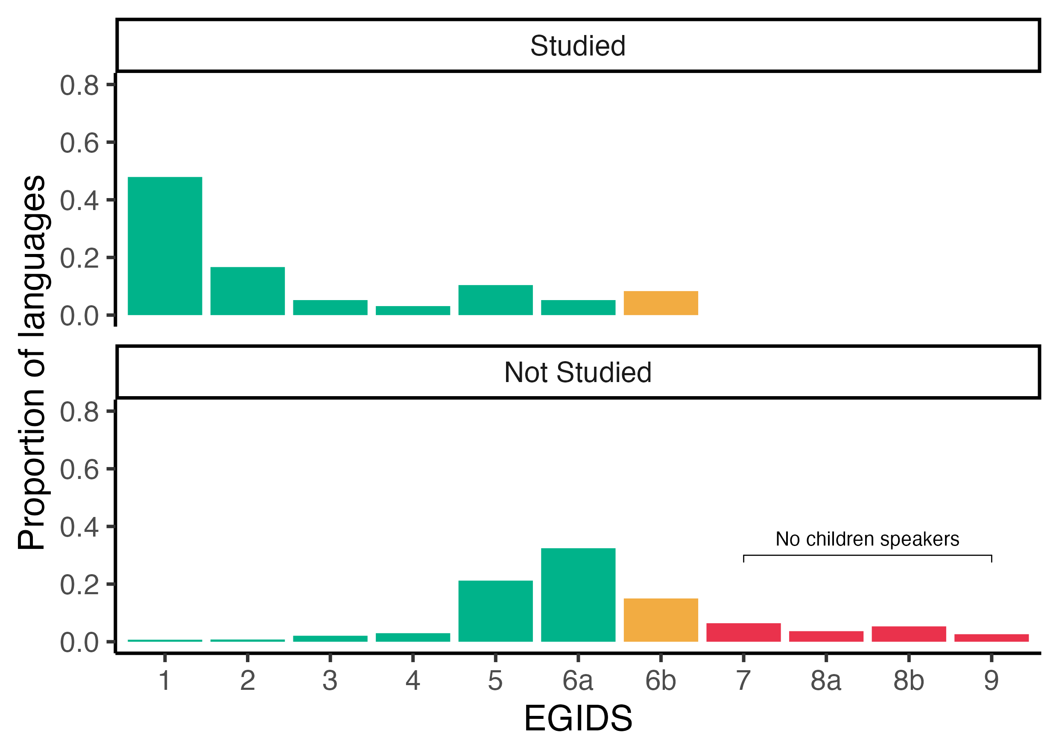
Endangerment status (Passmore & Kidd, in prep.)
Our preference for studying large accessible languages means that we are missing out on insights from fragile languages.
Notes:
- The problem with this skew is that we are, perhaps without realising it, studying large accessible languages at the expense of smaller more fragile but potentially more illuminating linguistic systems.
- Expanded Graded Intergenerational Disruption Scale

Slide 8
Locus of research production (Kidd & Garcia, 2022, First Language)
49% of research published by North American authors (mostly from USA).
38% from Europe (82% from Northern and Western Europe).
12% from Australia/NZ, East and West Asia.
1% from remainder of world.
Notes:
- No doubt one reason for the skew in data towards English and large European languages of Western Europe is due to the fact that we are most often studying ourselves, and there is more research production that occurs in wealthy countries.

Slide 9
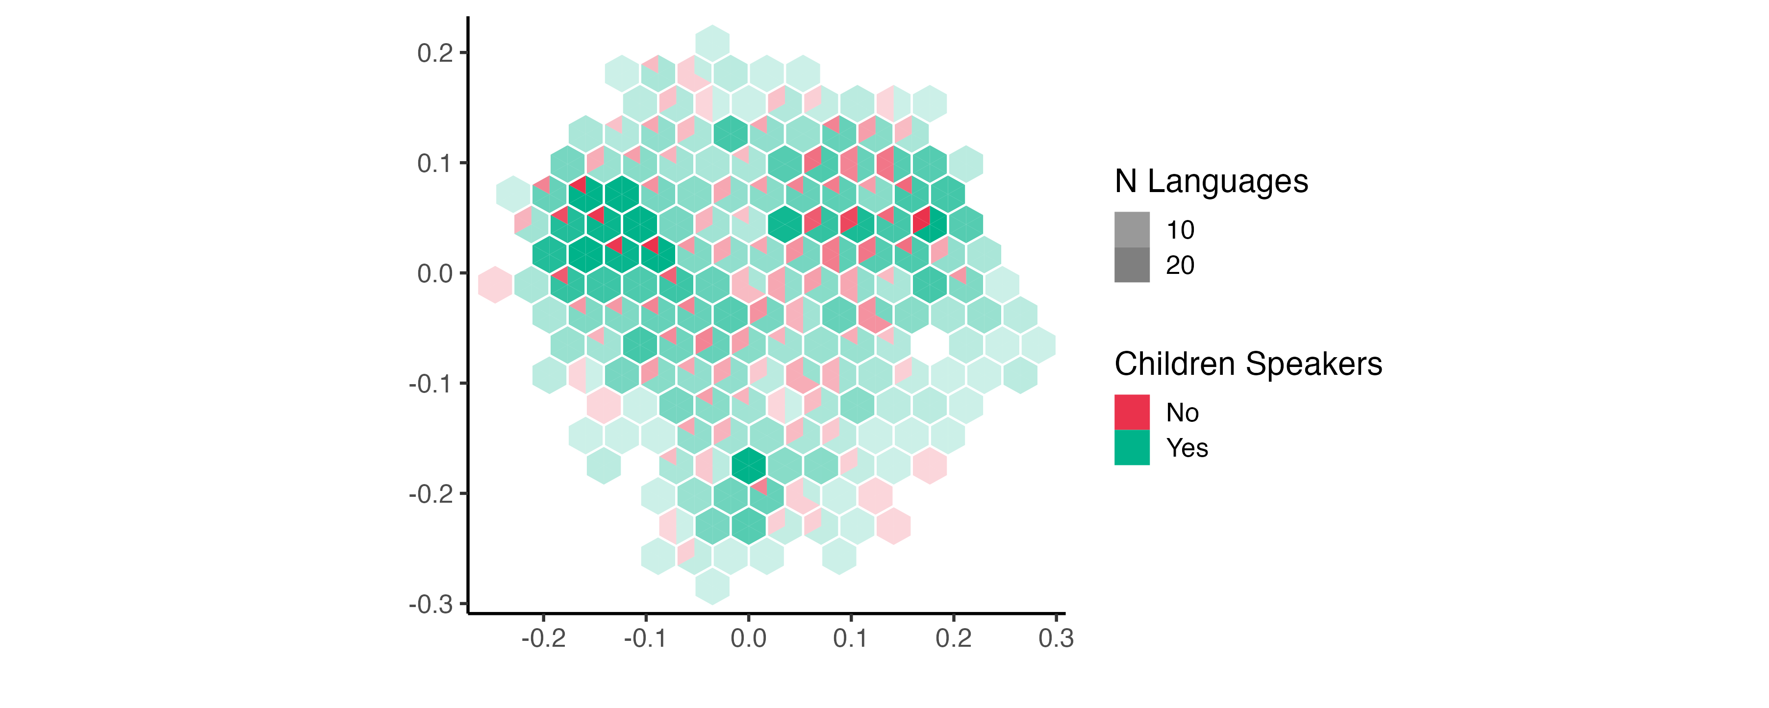
Grammatical diversity (Passmore & Kidd, in prep.)
2-D representation of design space of grammatical diversity – darker colours = more languages inhabit this ‘grammatical space’.

Slide 10
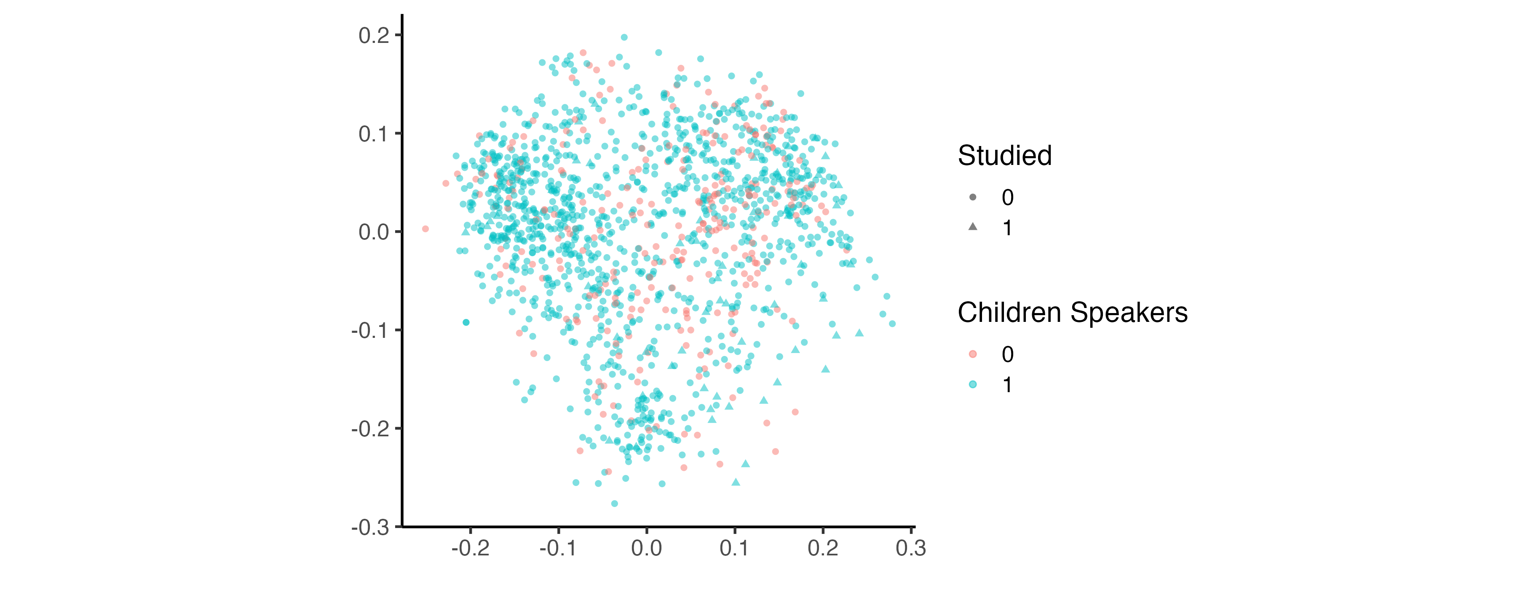

Slide 12
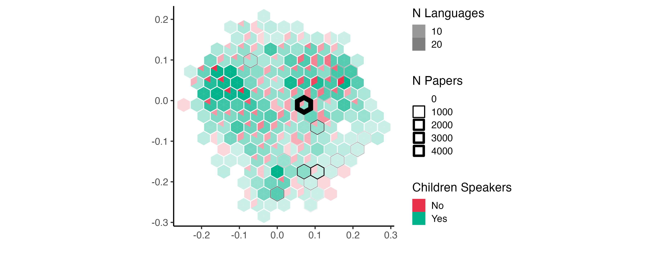

Slide 13
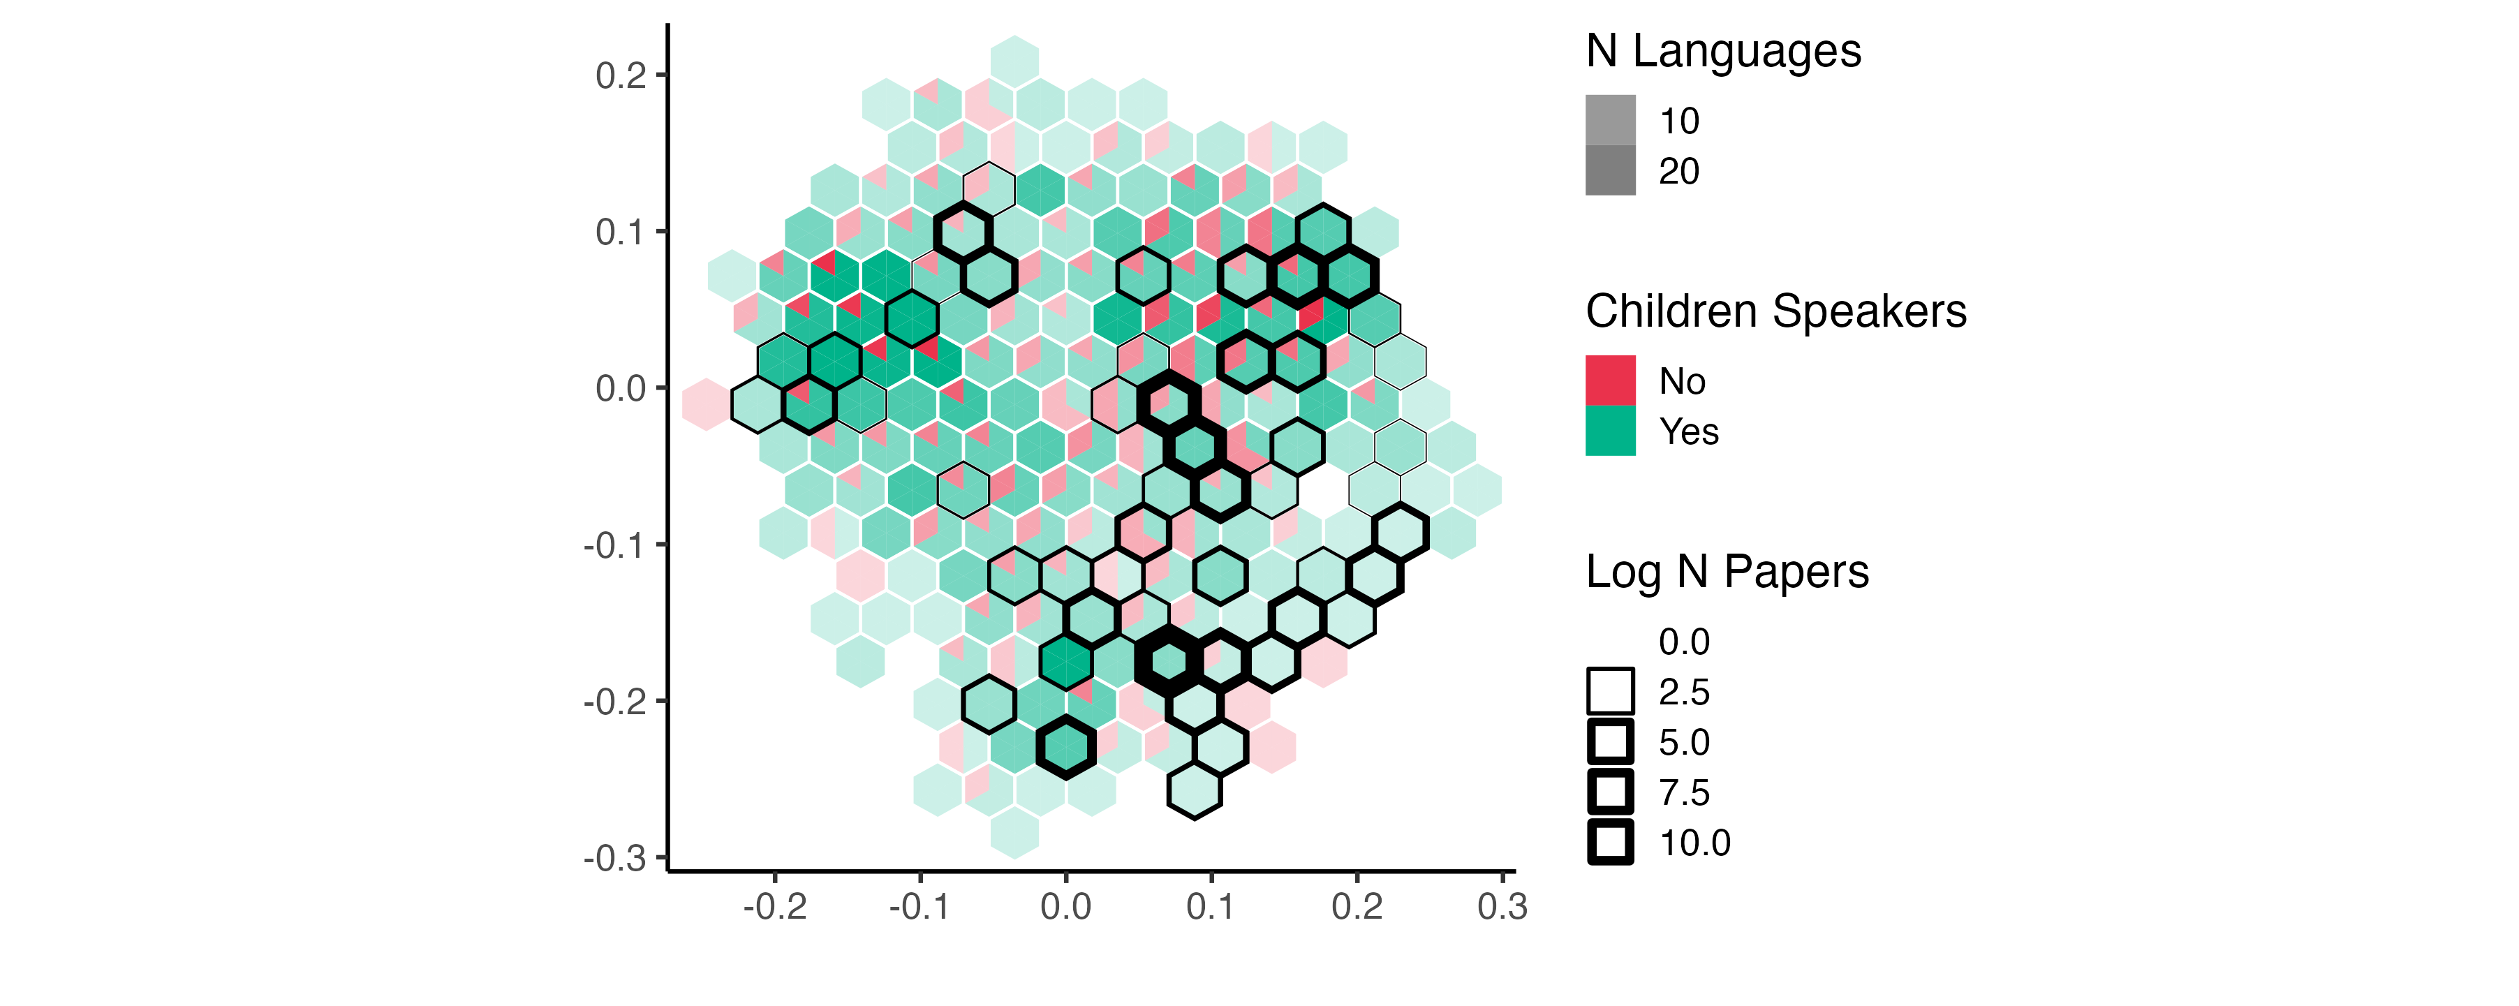

Slide 14
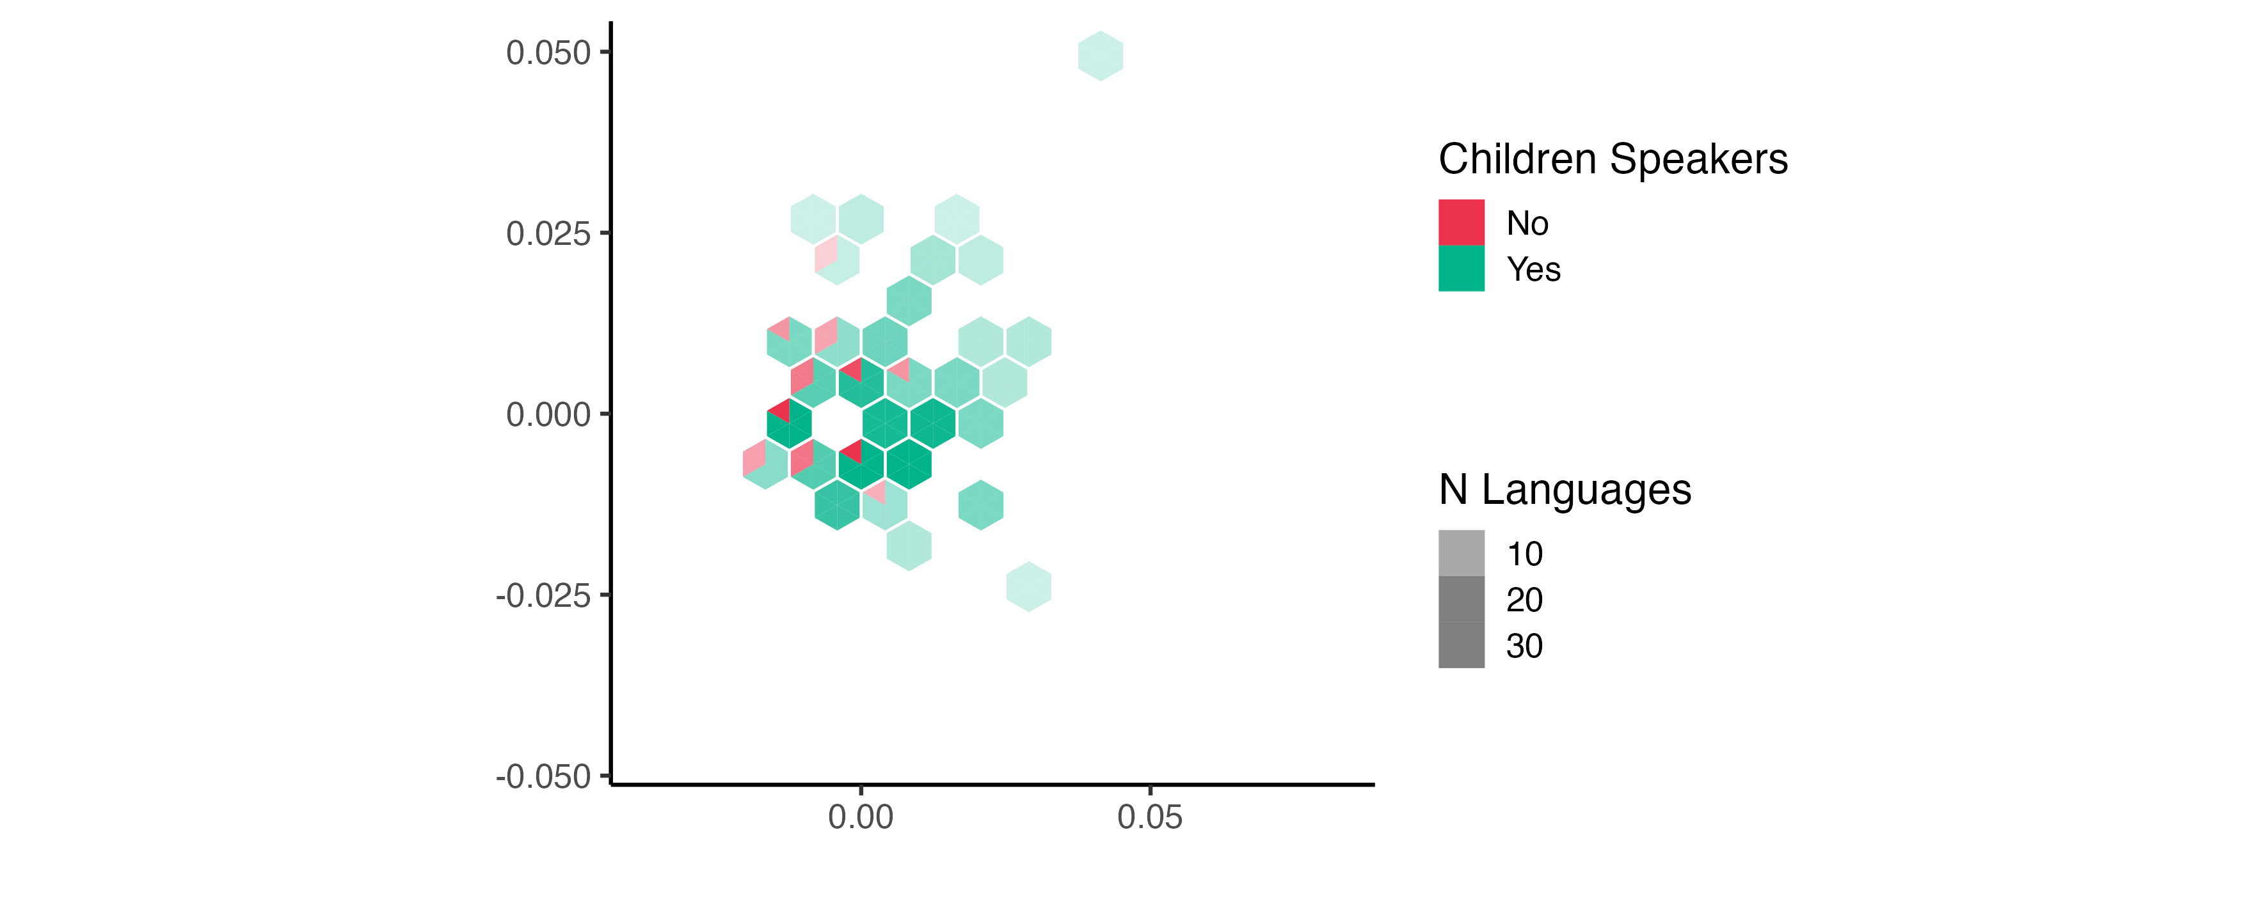
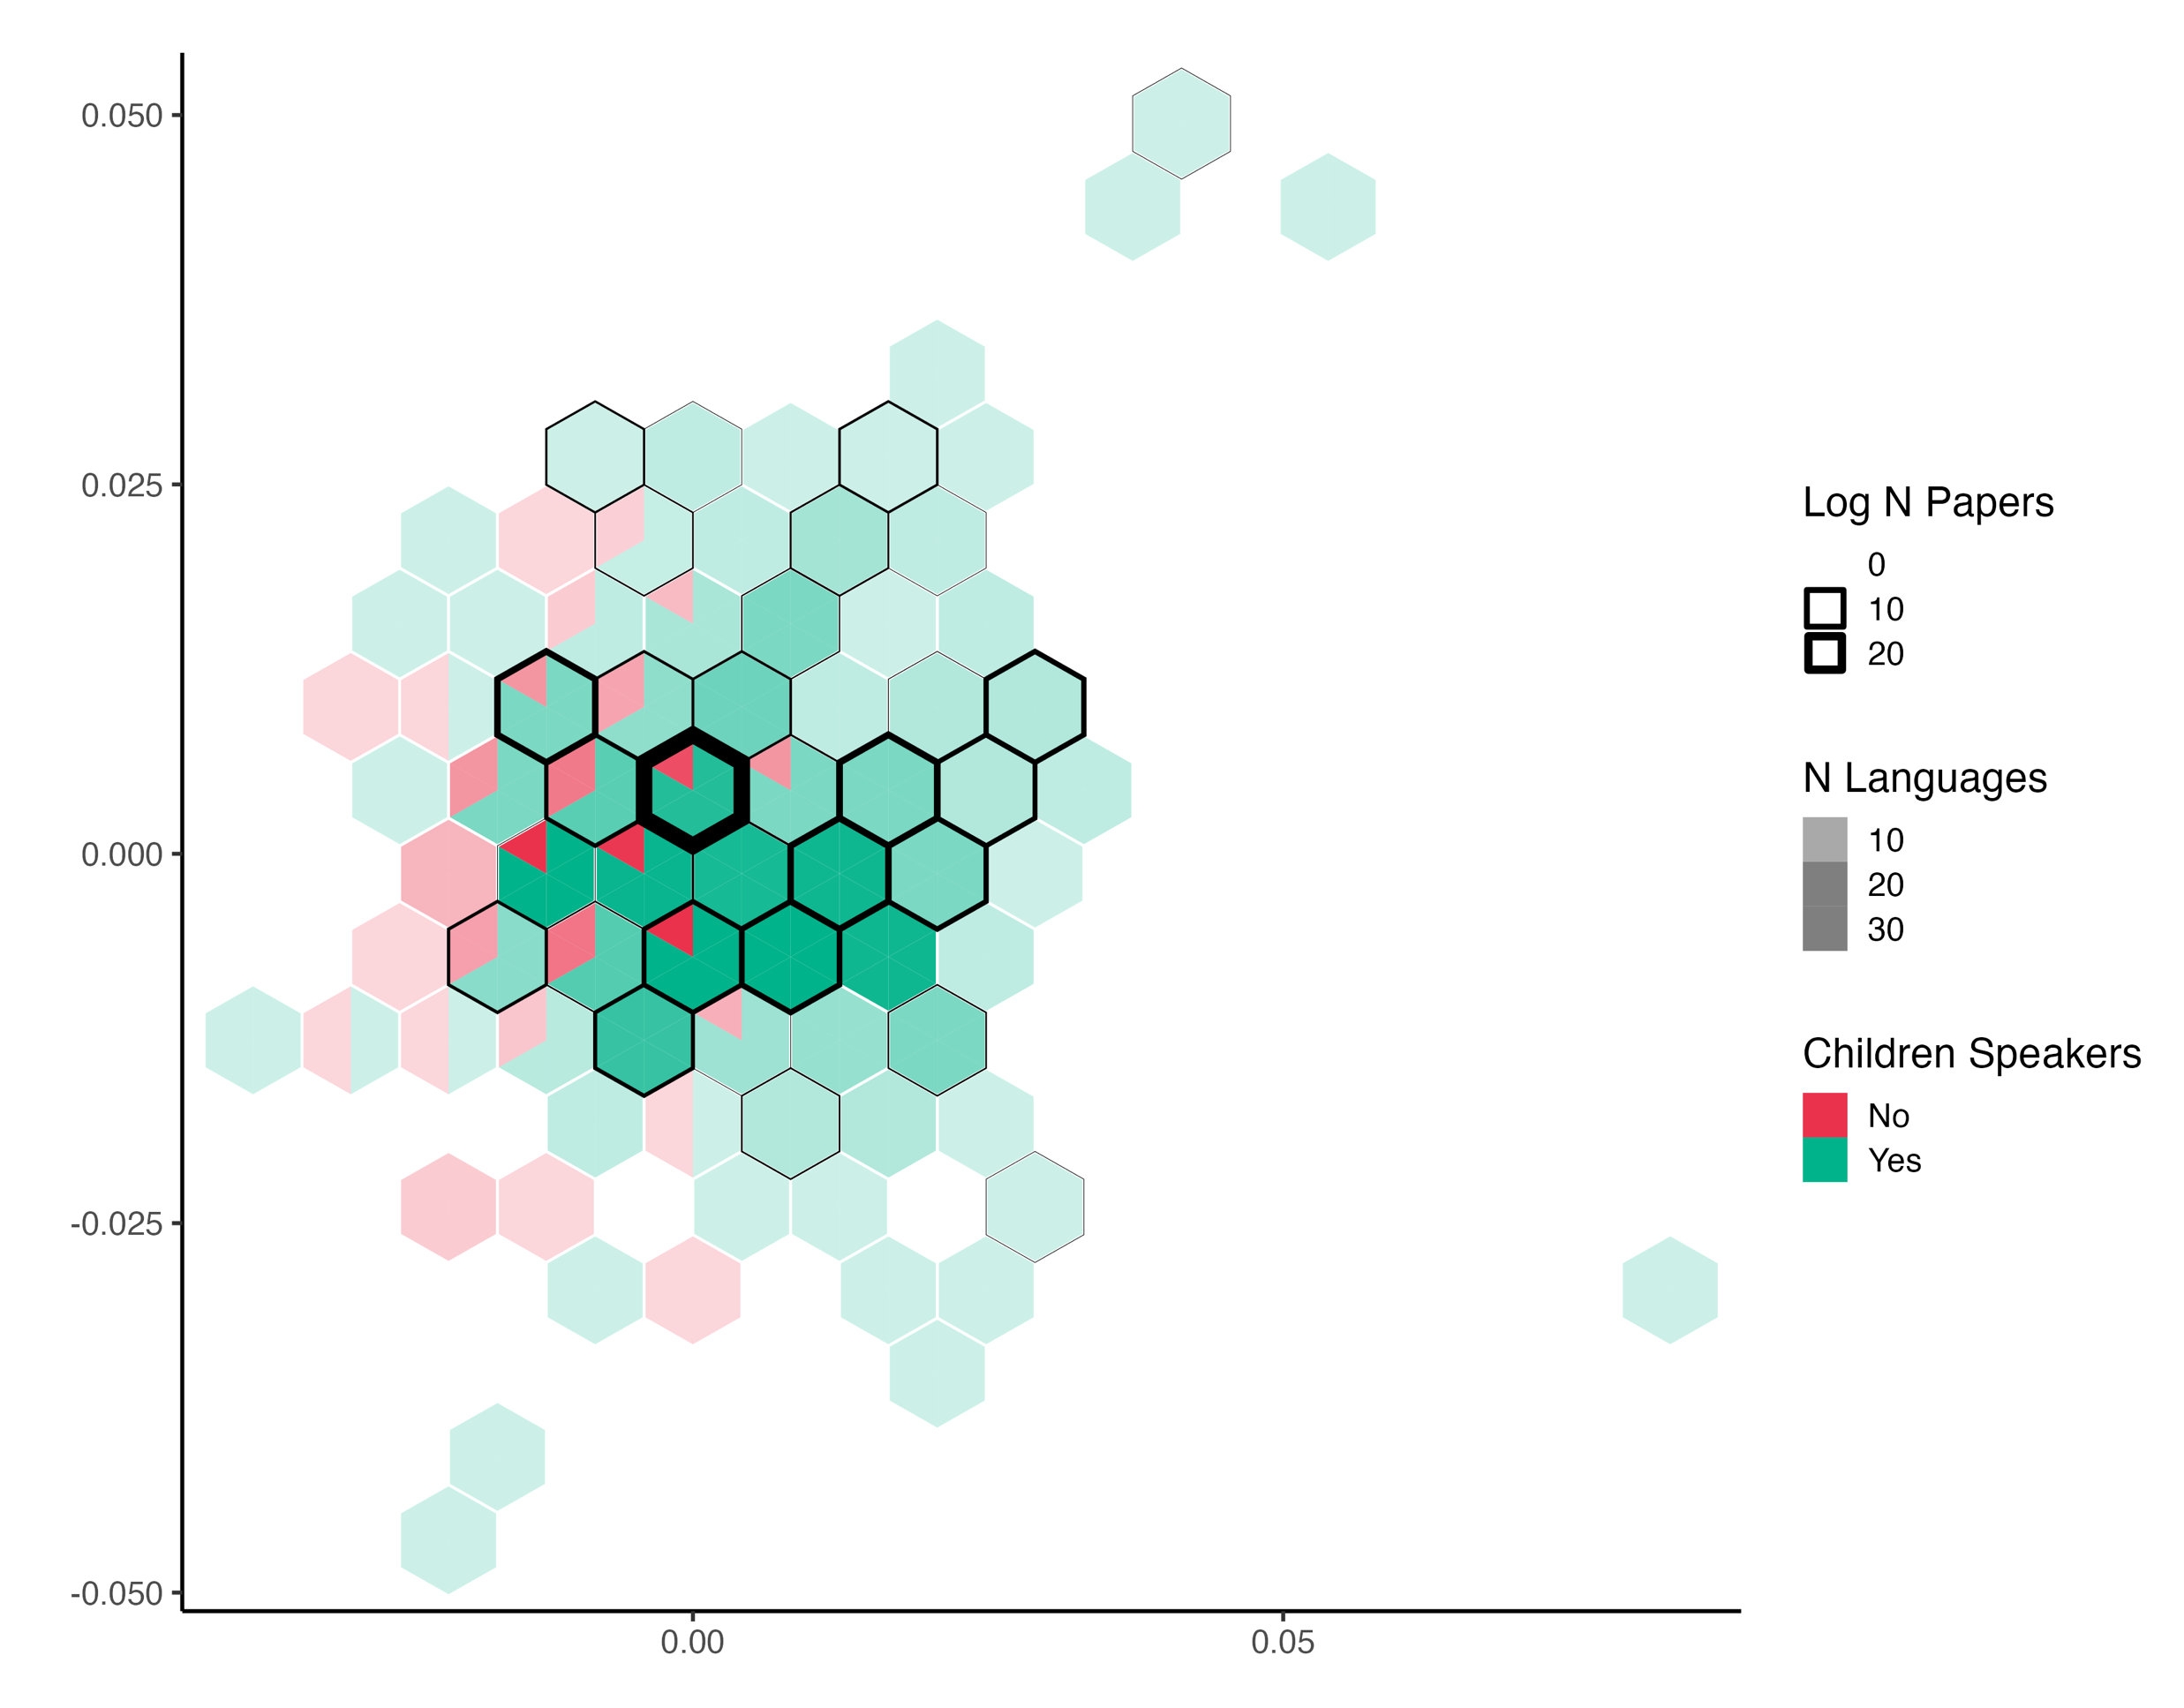
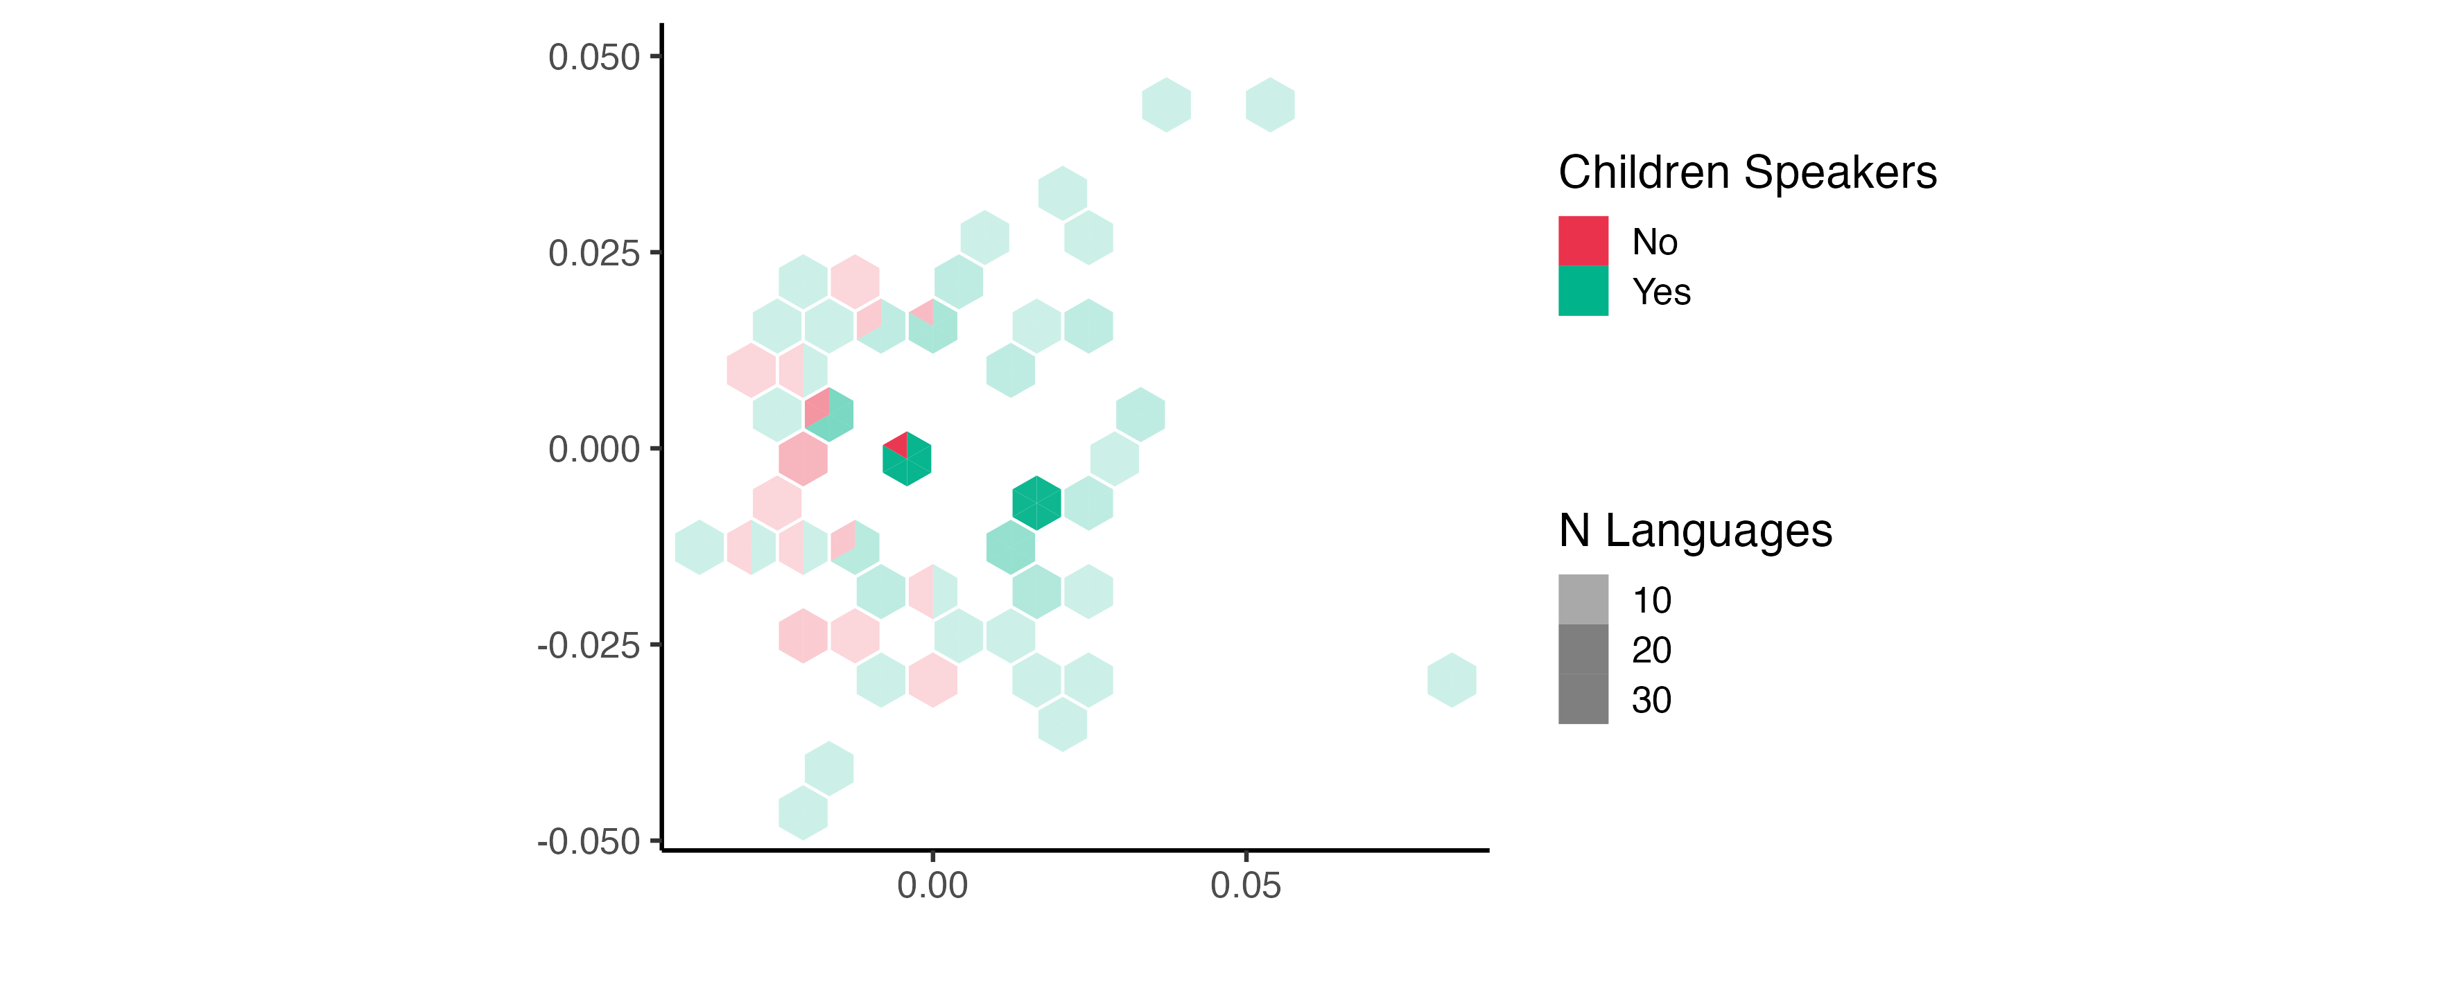
PHOIBLE: Phonological inventory data
Studied
Not Studied

Slide 15
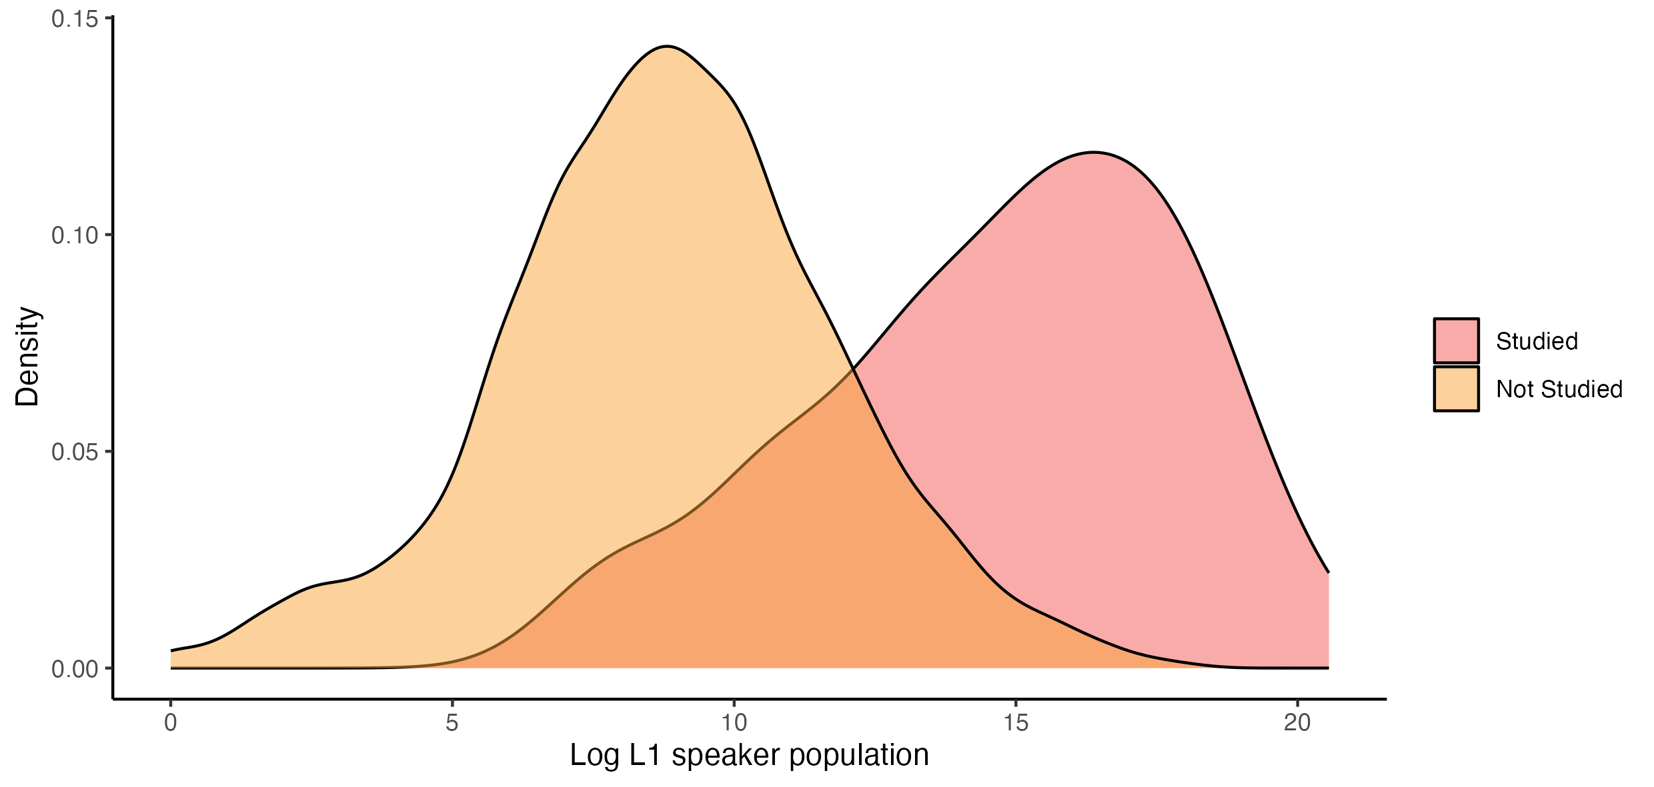
Population Distribution (Passmore & Kidd, In Prep)
A focus on languages with larger populations
Median studied speaker population: 3,827,000
Median unstudied speaker population: 5,150

Slide 16
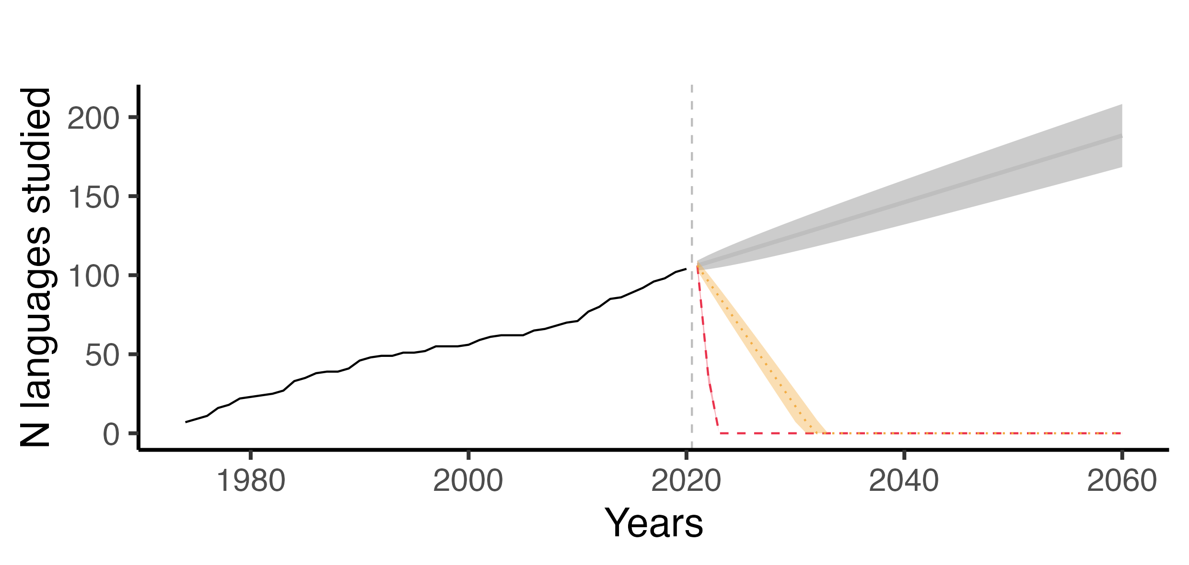
Endangerment status (Passmore & Kidd, in prep.)
Predicted number of new languages studied.
Approx. 2 per year
Notes:
This problem becomes even more clear when we consider the rate at which data from novel languages are being added to the literature versus language endangerment rates.

Slide 17
Endangerment status (Passmore & Kidd, in prep.)
Predicted number of new languages studied.
Rate of language loss
Bromham et al. (2022). Nature: Ecology & Evolution

Slide 18
Endangerment status (Passmore & Kidd, in prep.)
Predicted number of new languages studied.
Rate of language loss
Rate at which languages are becoming moribund (i.e., no child speakers).
Bromham et al. (2022). Nature: Ecology & Evolution

Slide 19
Conclusions
Child language acquisition research is severely skewed towards English and a handful of large and secure (mostly European) languages.
Theoretical cost: focusing on a small set of unrepresentative languages limits our ability to study acquisition across the entire design space of human language.
Human cost:
“…future ages will look back upon us so immersed in the analysis of child language as to be blind to higher considerations. They will charge us with having culpably allowed the destruction of some of those records of diversity which we had in our power to preserve…” (Pye, 2021, p. 474).

